Slide 1
FIN 654: FINANCIAL Analytics
SUPPLEMENT Week 6
Note: Code contained here is from a mix of sources as listed in References Slide(s)

Slide 2
Shiny Architecture
UI (User Interface)
Server (input, output)
Analytics (modules)
Data
App Template
library(shiny)
ui <- fluidPage(
## Example: Slider Inputs ##
)
server <- function(input, output) {
## Example: renderPlot({ })
}
## Run the application
shinyApp(ui = ui, server = server)

Slide 3
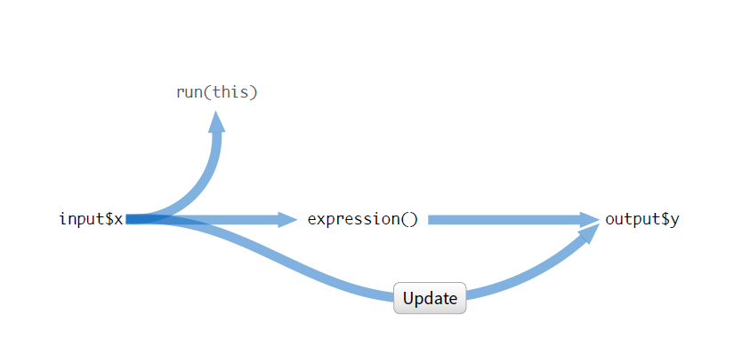
Shinyapp RUN

Slide 4
Reactivity
Reactive Values
The input value changes whenever a user changes the input.
Reactive values work together with reactive functions. You cannot call a reactive value from outside of one.
Reactivity in R as a two step process
Reactive values notify the functions that use them when they become invalid
The objects created by reactive functions respond (different objects respond differently)
Displaying output with render()
renderDataTable() An interactive table
renderImage() An image (saved as a link to a source file)
renderPlot() A plot
renderPrint() A code block of printed output
renderTable() A table
renderText() A character string
renderUI() a Shiny UI element

Slide 5
Shinyapp Examples
library(shiny)
ui <- fluidPage(
sliderInput(inputId = "num",
label = "Choose a number",
value = 25, min = 1, max = 100),
plotOutput("hist")
)
server <- function(input, output) {
output$hist <- renderPlot({
hist(rnorm(input$num))
})
}
shinyApp(ui = ui, server = server)
library(shiny)
require(scatterplot3d)
ui <- fluidPage(
titlePanel("Helix Plot"),
sidebarLayout(
sidebarPanel(
sliderInput(inputId="start","Sequence start:", min = -30,max = -10,value = -20),
sliderInput(inputId="stop","Sequence stop:", min = 10,max = 30,value = 10),
sliderInput(inputId="incr","Sequence incr:", min = 0.01,max = 0.10,value = 0.01)),
mainPanel(plotOutput("plot3d")))
)
server <- function(input, output) {
output$plot3d <- renderPlot({
z <- seq(input$start, input$stop, input$incr)
x <- cos(z)
y <- sin(z)
scatterplot3d(x, y, z, highlight.3d = TRUE,
col.axis = "blue", main = "Helix", pch = 20)})
}
shinyApp(ui = ui, server = server)

Slide 6
Shinyapp links
https://rmarkdown.rstudio.com/flexdashboard/shiny.html
https://shiny.rstudio.com/tutorial/
http://docs.rstudio.com/shinyapps.io/
http://shiny.rstudio.com/images/shiny-cheatsheet.pdf
https://vimeo.com/rstudioinc/review/131218530/212d8a5a7a/#t=3m42s
https://www.datacamp.com/courses/building-web-applications-in-r-with-shiny
https://info201-s17.github.io/book/shiny.html
https://blog.learningtree.com/building-data-driven-web-applications-using-r-shiny/
https://github.com/rstudio/shiny/issues/
https://mytinyshinys.shinyapps.io/spotifyFlexDB/

Slide 7

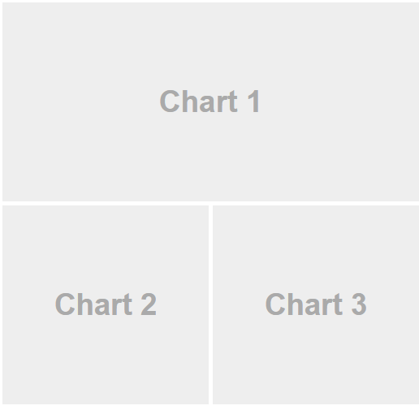
Flexdashboard and Shinyapp
R Markdown for data visualizations as a dashboard.
Components like htmlwidgets; base, lattice, and grid graphics; tabular data; gauges and value boxes; and text annotations.
Layouts that are row and/or column-based with auto-sizing of components for display on desktops, laptops, tablets and mobile devices.
Storyboard layouts for arranging order of visuals and commentaries.
Shiny to drive dynamics of visualizations.
R markdown manages the calls to shinyApp().

Slide 8
Quandl As a Data Source
Making a time-series call
data <- Quandl("FRED/GDP")
Changing formats
data <- Quandl("FRED/GDP", type="raw")
data <- Quandl("FRED/GDP", type="ts")
data <- Quandl("FRED/GDP", type="xts")
data <- Quandl("FRED/GDP", type="zoo")
Filtering a time-series call
data <- Quandl("FRED/GDP", start_date="2001-12-31", end_date="2005-12-31")
data <- Quandl(c("FRED/GDP.1", "WIKI/AAPL.4"))
Preprocessing the data
data <- Quandl("FRED/GDP", collapse="annual")
data <- Quandl("FRED/GDP", transform="rdiff")
Making a multiple time-series call
merged_data <- Quandl(c('EXMPL/DATA1', 'EXMPL/DATA2'))
merged_data <- Quandl(c('EXMPL/DATA1.1', 'EXMPL/DATA2.2'))
Downloading an entire time-series dataset
Quandl.database.bulk_download_to_file("ZEA", "./ZEA.zip")
Notes:
Refer https://docs.quandl.com/docs/r-time-series

Slide 9
Quandl Data Example
# Function to get data
getdataql <- function (q_code, col_no, clabel) {
require(Quandl)
mydata.ee <- Quandl(q_code,
api_key="tzyKE21cvbzCY8pxDnPg")
data.ee <- data.frame(as.Date(mydata.ee[, 1]),
mydata.ee[, col_no])
head(data.ee)
colnames(data.ee) <- c("DATE", clabel)
return(data.ee)
}
# Check and write data into a csv file one-time
datafile <- "data/data_m3.csv"
if(!file.exists(datafile)){
data.cu <- getdataql("LME/PR_CU", 2, "COPR")
data.au <- getdataql("LBMA/GOLD", 3, "GOLD")
data.ag <- getdataql("LBMA/SILVER", 2, "SLVR")
data1 <- merge(data.cu, data.au, by.x = "DATE",
by.y = "DATE")
data2 <- merge(data1, data.ag, by.x = "DATE",
by.y = "DATE")
data2$DATE <- as.character(data2$DATE,
format = "%m/%d/%Y")
head(data2)
write.table (data2, file=datafile, sep=",", row.names=F)
}
data.x <- na.omit(read.csv(datafile, header = TRUE))

Slide 10
Stock Data Example
# Getting historical stock data
require(tseries)
msftDailyPrices <- get.hist.quote(instrument="msft", start="1998-01-01", end="2012-05-31",
quote="AdjClose", provider="yahoo", origin="1970-01-01", compression="d", retclass="zoo")
colnames(msftDailyPrices) <- "MSFT"
sp500DailyPrices <- get.hist.quote(instrument="^gspc", start="1998-01-01", end="2012-05-31",
quote="AdjClose", provider="yahoo", origin="1970-01-01", compression="d", retclass="zoo")
colnames(sp500DailyPrices) <- "SP500"
#
require(PerformanceAnalytics)
DailyPrices <- merge(msftDailyPrices, sp500DailyPrices)
DailyReturns <- Return.calculate(DailyPrices, method="simple")[-1]
colnames(DailyReturns) <- c("MSFT", "SP500")
qqplot(DailyReturns$MSFT, DailyReturns$SP500)
ccf(ts(DailyReturns$MSFT), ts(DailyReturns$SP500), lag = 20)

Slide 11
Partial List of Data Sources
https://www.quandl.com/search?query=
https://fred.stlouisfed.org/categories
https://www.eia.gov/<energy>/data.php ## <energy> is petroleum, naturalgas, electricity, etc.
https://finance.yahoo.com/quote/<sym>/history?ltr=1 ## <sym> is ticker symbol
https://finance.google.com/finance
https://www.indexmundi.com/commodities/
https://www.lme.com/en-GB/Market-Data
https://www.oanda.com/forex-trading/analysis/economic-indicators/united-states
https://www.treasurydirect.gov/govt/reports/pd/mspd/mspd.htm
http://www.wsj.com/mdc/public/page/2_3020-tstrips.html

Slide 12
Reference books
Bennet and Hugen. 2016. Financial Analytics with R: Cambridge Univ Press.
Paul Teetor. 2011. R Cookbook. O’Reilly: Sebastopol, CA.
Phil Spector. Data Manipulation with R.
Norman Matloff. The Art of R Programming: A Tour of Statistical Software Design.
John Taveras. R for Excel Users at https://www.rforexcelusers.com/book/.
Winston Chang. 2014. R Graphics Cookbook. O’Reilly: Sebastopol, CA.

Slide 13
Reference links
http://www.cookbook-r.com/
https://books.google.com/books?id=fxL4tu5bzAAC&printsec=frontcover
https://www.datacamp.com/courses/free-introduction-to-r
http://www.r-tutor.com/r-introduction/
https://www.statmethods.net/
https://livebook.manning.com/#!/book/r-in-action-second-edition/
https://blog.rstudio.com/2015/06/24/leaflet-interactive-web-maps-with-r/
https://www.analyticsvidhya.com/blog/2015/07/guide-data-visualization-r/
https://jabranham.com/blog/2015/09/rmarkdown-vs-latex/
https://www.revolvy.com/main/index.php?s=YAML

